Slide 1
Protecting Forests and Infrastructure from Fire with Drones
Presented by: Tracey Begaye
Mentor: Pete Fule, Regent's Professor, School of Forestry, NAU
NASA Space Grant Statewide Symposium
Saturday, April 22, 2023

Slide 2
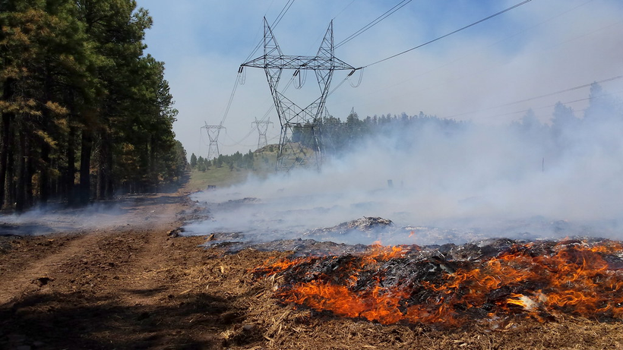
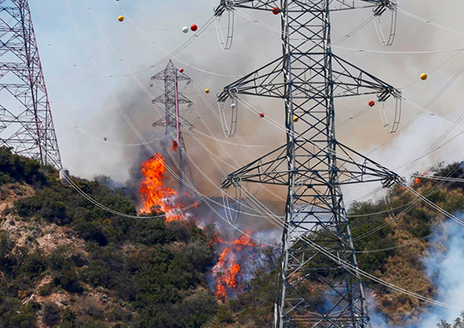
Statement of the Problem
Utility line corridors affected by forest fire
Towers serve the Phoenix area
Research forest fuel using tree metrics
Figure 1: Northern Arizona Forest Fire
Source: Coconino National Forest Photography
Figure 2: Uility Fire
Source: Enriching Technical Knowledge of T&D Professionals

Slide 3
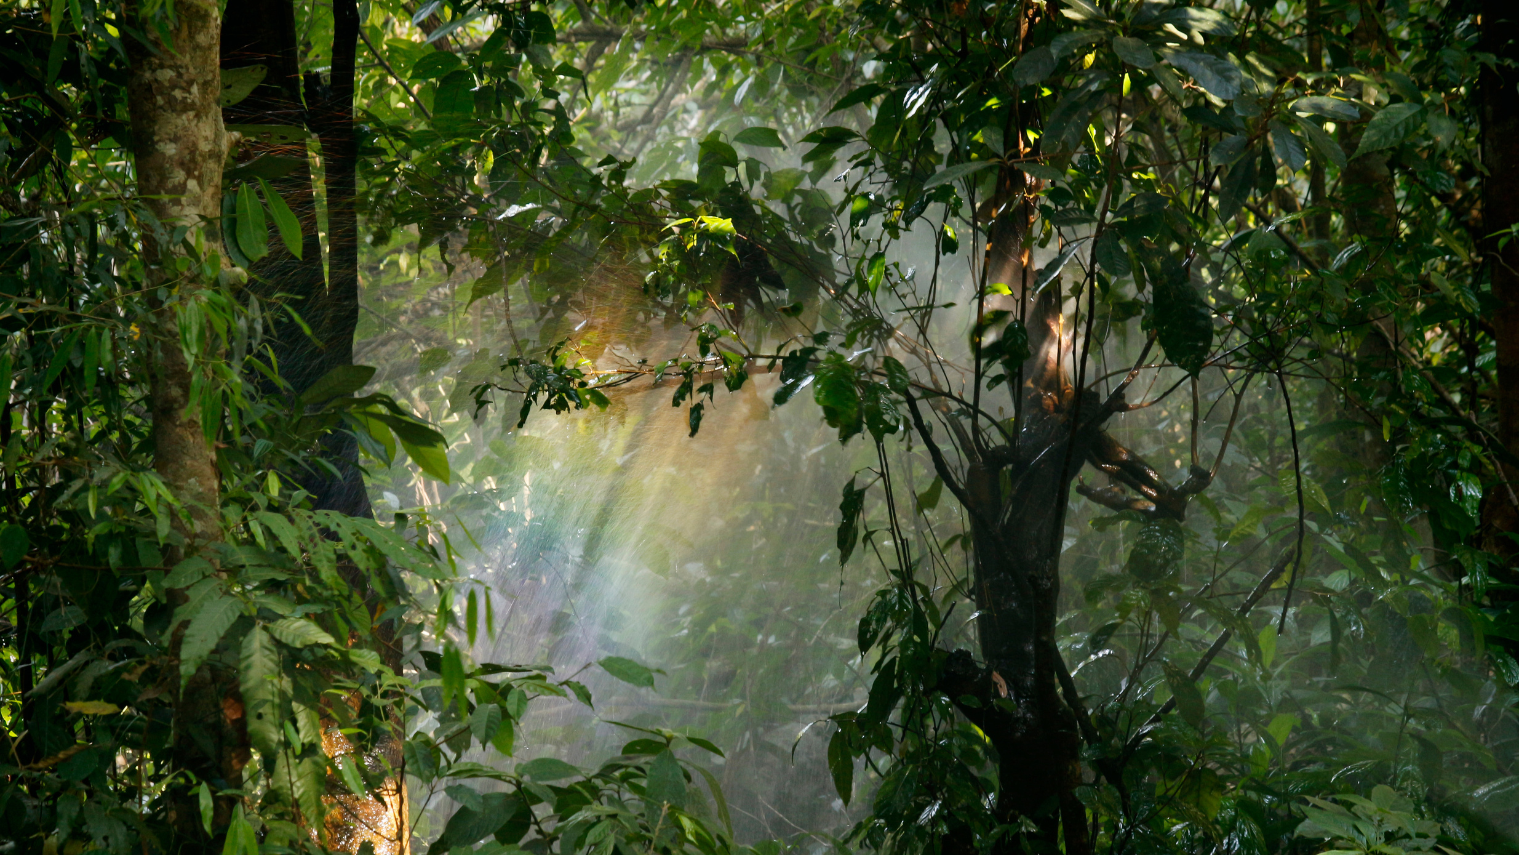
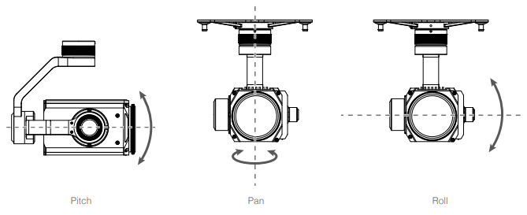
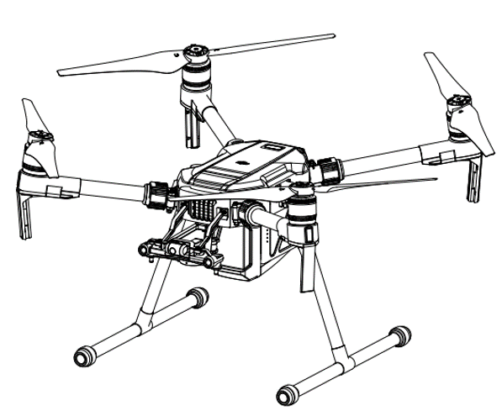
Methods
Fly drones at different heights over utility line corridors to collect data
Measure fuel hazards
Structure from Motion (SfM)
Technique for three-dimensional visualization using images taken from different locations
Computer software (Metashape)
Stitch the photos into a 3-D scene, called a point cloud
Figure 3: Camera Gimbal
Figure 4: DJI Matrice 200

Slide 4
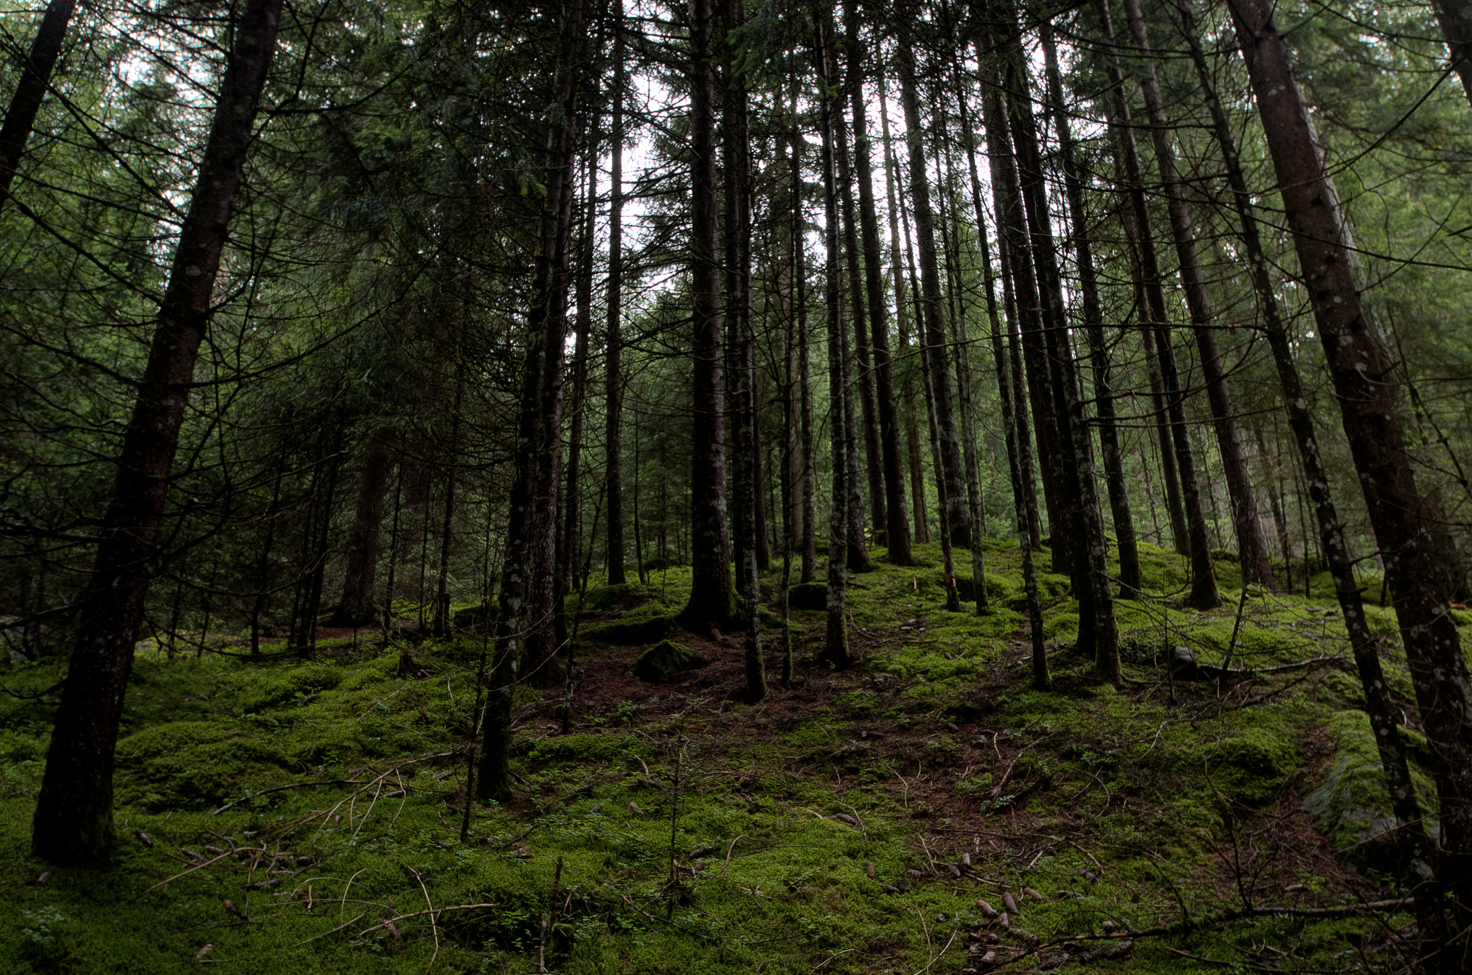
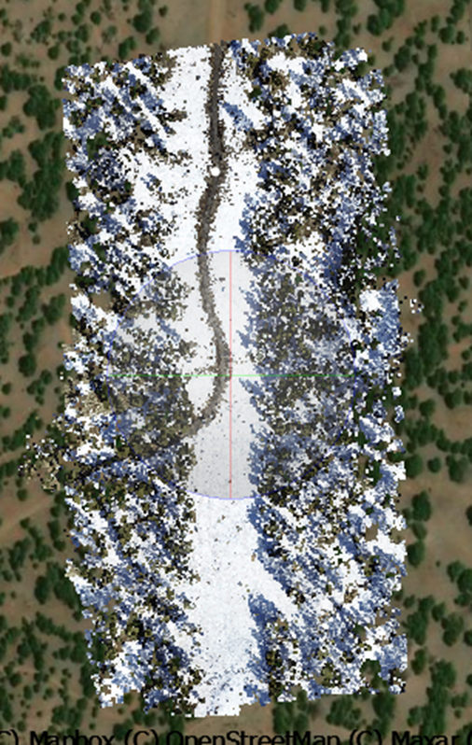
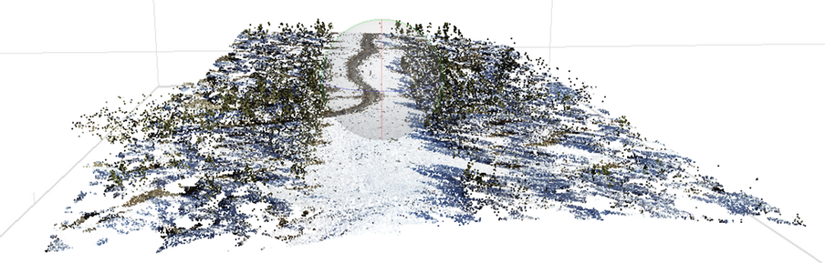
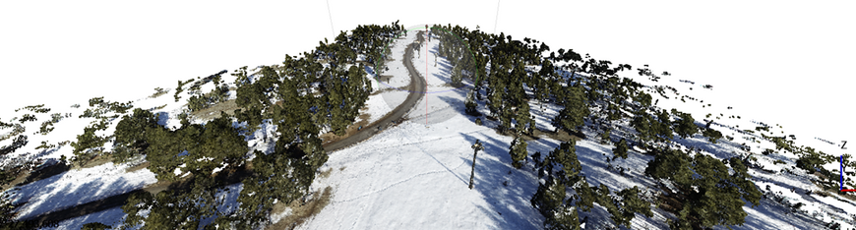
Results
Use point cloud data to compute forest fuel metrics
Canopy base height, canopy cover, tree segmentation, individual tree location, & tree height
These parameters help forecast the behavior of forest fires
Figure 6: Point Cloud
Figure 5: Plot with GPS
Figure 7: Dense Cloud

Slide 5
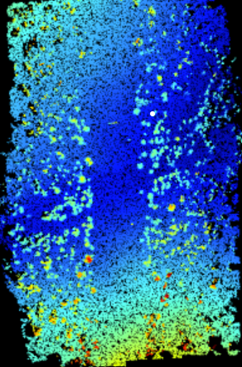
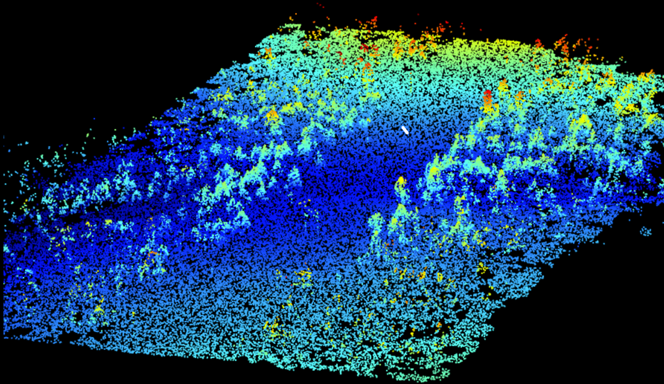
Results -
Continued
Digital terrain model
Classification of ground points & elevation
Accuracy of these models = better tree height estimation
Figure 8: Nadir View
Figure 9: Oblique View

Slide 6
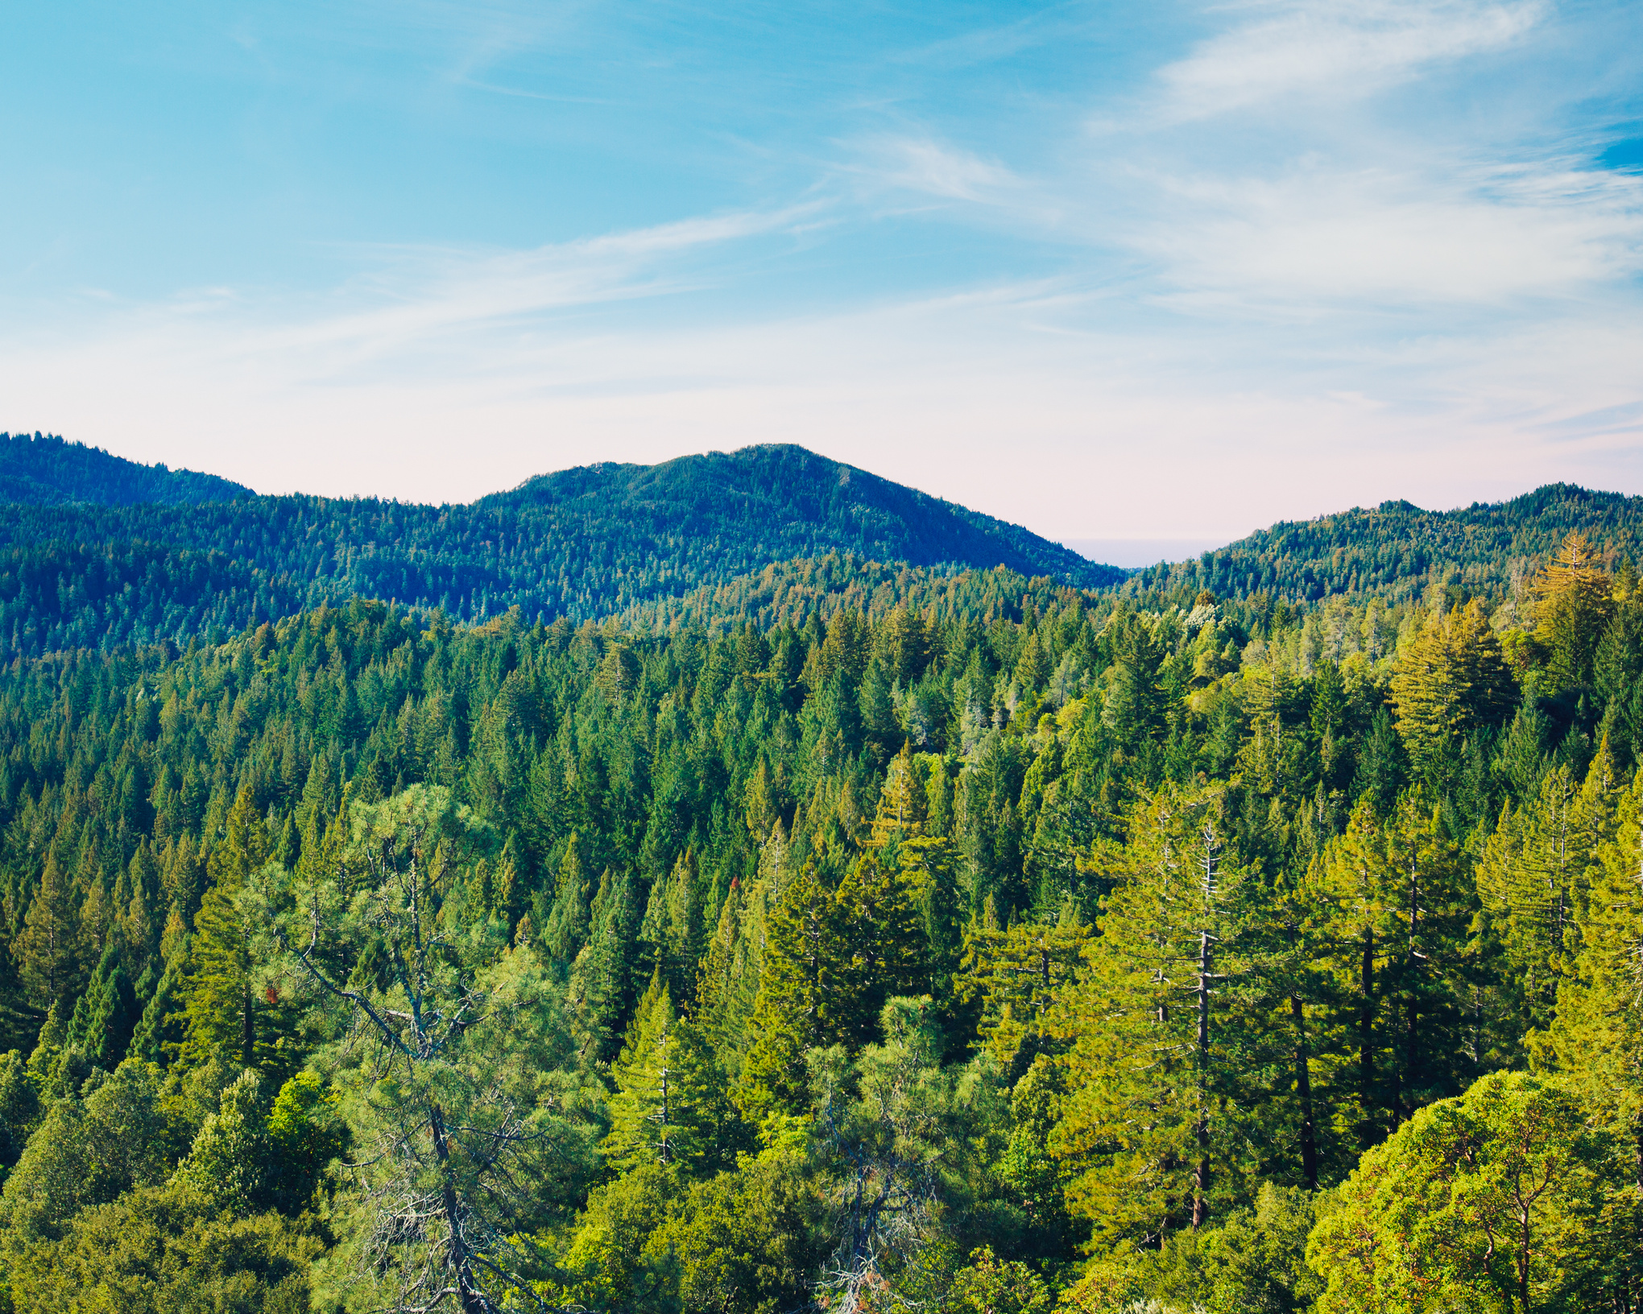
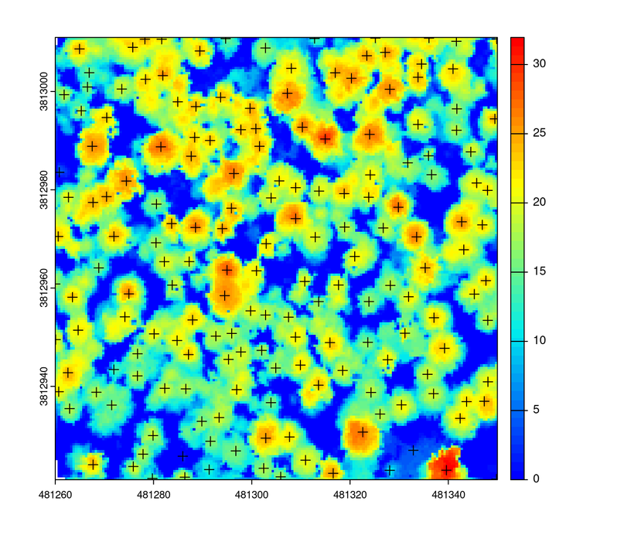
Results - Continued
Coordinates
Canopy data
Create a model & it can predict how long/big the fire will be
Inputs are crucial
Individual tree location provides tree density & size
Thinning forests
Tree Height (m)
Figure 10: Tree Segmentation
Coordinates
Figure 11: Individual tree location using canopy height model

Slide 7
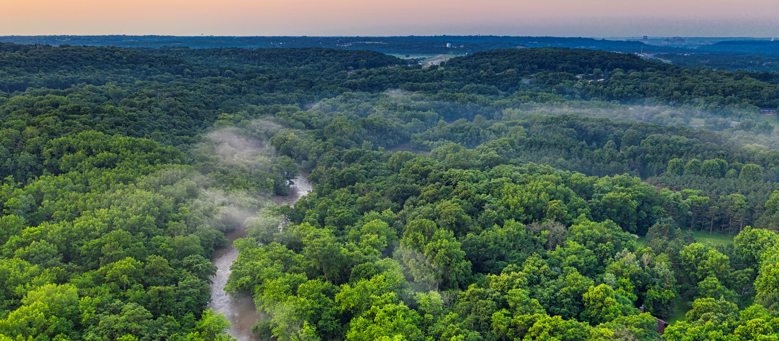
Impact
Meaningful collaborations on Navajo Nation with Diné College & Salt River Project
Foresters, utility providers, & fire managers will all receive access to our research
Maintain & conserve the ecology of Northern
Arizona

Slide 8
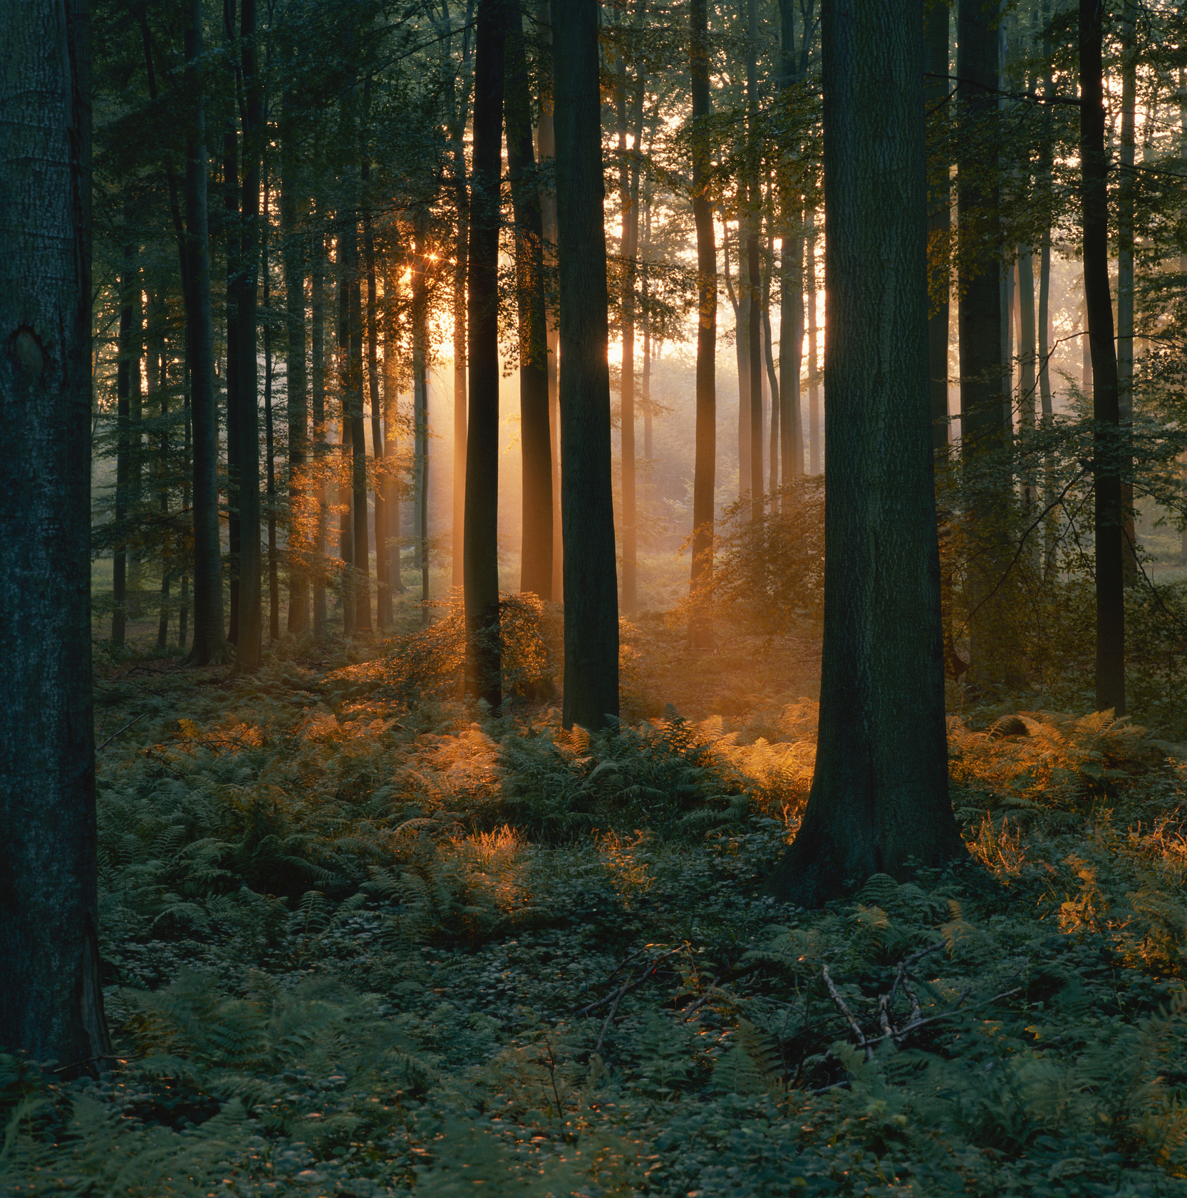
Acknowledgements
Pete Fule - Mentor, Regent's Professor
Leo O'Neill - Lab/Group Partner
NAU/NASA Space Grant Program
Paloma Rose Davidson (Senior Academic Program Coordinator)
School of Forestry

Slide 9
Ahéhee'
Thank You!

